Slide 1
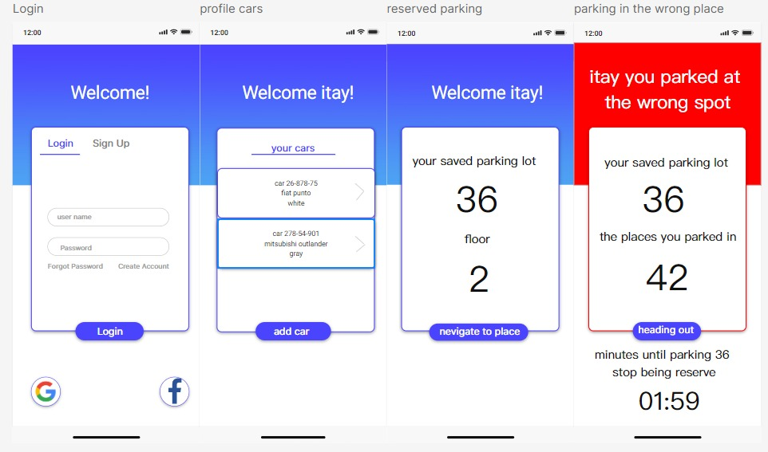
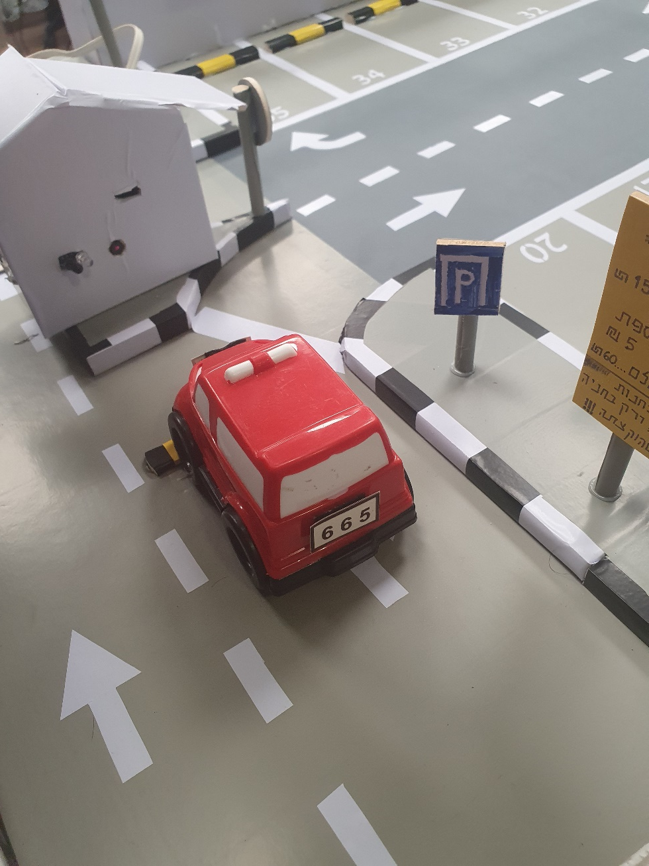
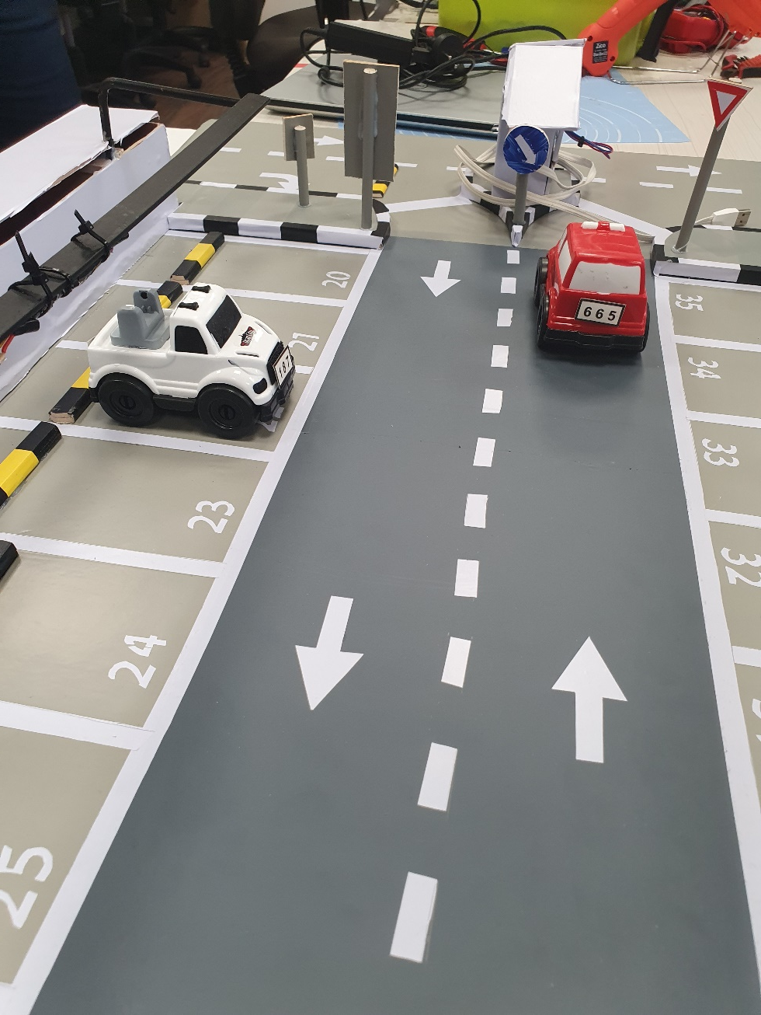
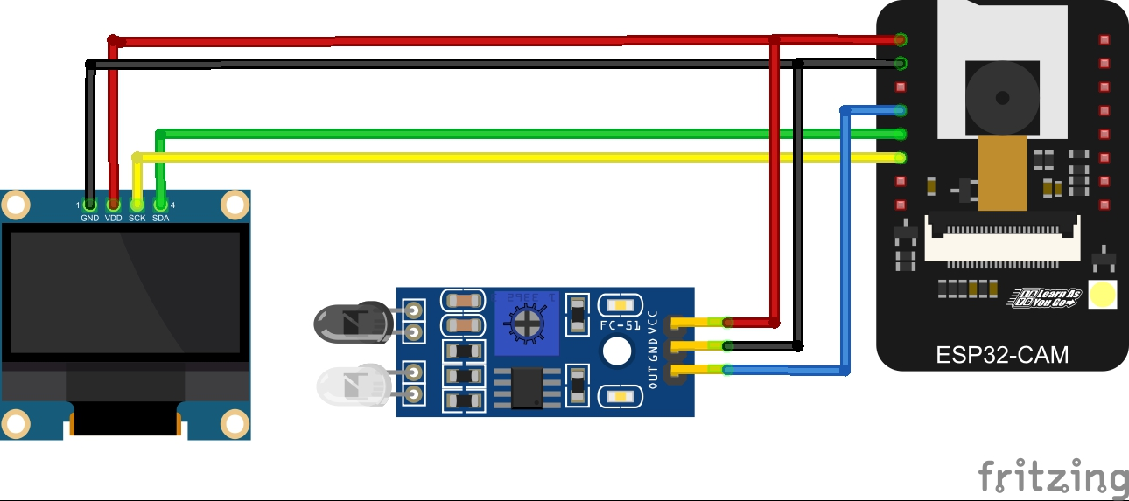
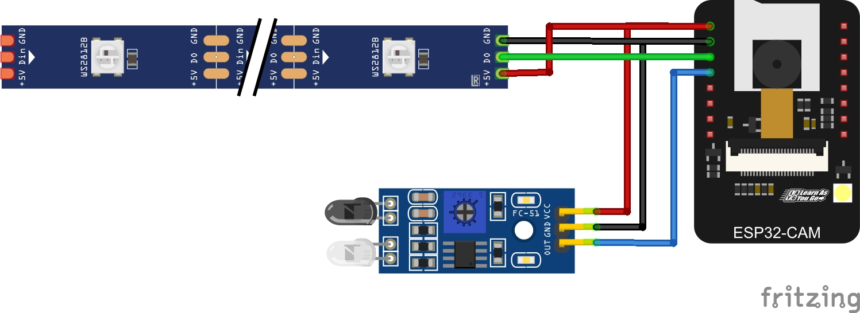
Smart Parking
Find parking easily and quickly!
Designated parking according to identification board
Problem - tiresome search for an empty parking lot
solution - Direct an empty parking using a parking management system
Features - vehicle arrival detection, license plate detection and finding empty parking
Uniqueness - a special parking space is reserved for each vehicle
An application that saves the details of the driver's vehicles and updates which parking has been saved
The vehicle is identified at the entrance to the parking lot
The vehicle entered the parking lot assigned to it
Wiring Diagram of the gate Includes camera, proximity sensor and screen
Wiring Diagram of the parking space Includes camera, proximity sensor and LEDs of access privileges
Dan Sdeor, Uri Ben-hur, Tsahi Edri, Guy Kahana, Levi Hurvitz
Yosef break, ahlam abu gush, Ofek Bengal Shmueli, Ido Ram Kiri, Itay Dabran

